Slide 1





Module 08 – Sockets
WWW.SELACLOUD.COM

Slide 2

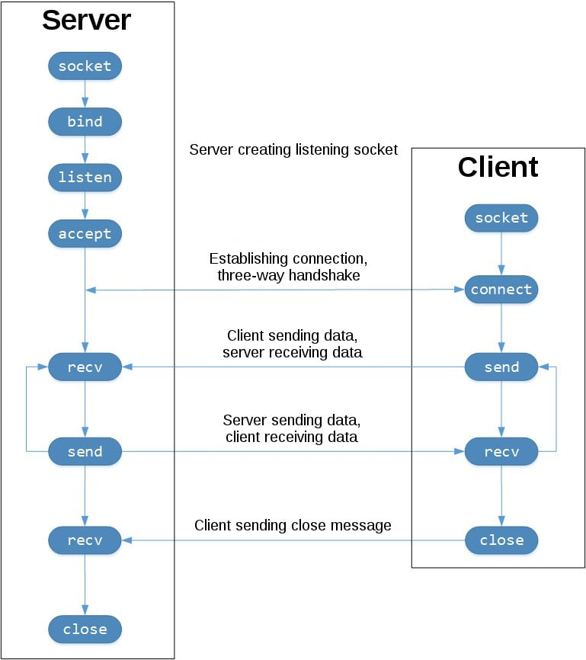
What Is A Socket?
Socket is an endpoint for communicating processes across a network. The socket mechanism is versatile, supporting both connection oriented communications (stream sockets) providing point to point communications, and connectionless communications (datagram sockets) providing the ability to broadcast information.
An applications plugs in to the network, sending and receiving data, through a socket.
The socket mechanism allows the programmer full control over virtually every aspect of the programming. Which protocol transport the data, the domain, etc.
Notes:
Python is dynamically-typed and garbage-collected. It supports multiple programming paradigms, including structured (particularly, procedural), object-oriented and functional programming.
It was built to be as readable as possible, and is significant indentation driven (Off-side rule).
The language's core philosophy is summarized in the document The Zen of Python (PEP 20), which includes aphorisms such as:
Beautiful is better than ugly.
Explicit is better than implicit.
Simple is better than complex.
Complex is better than complicated.
Readability counts.
For further reading:
Python (programming language) - Wikipedia

Slide 3
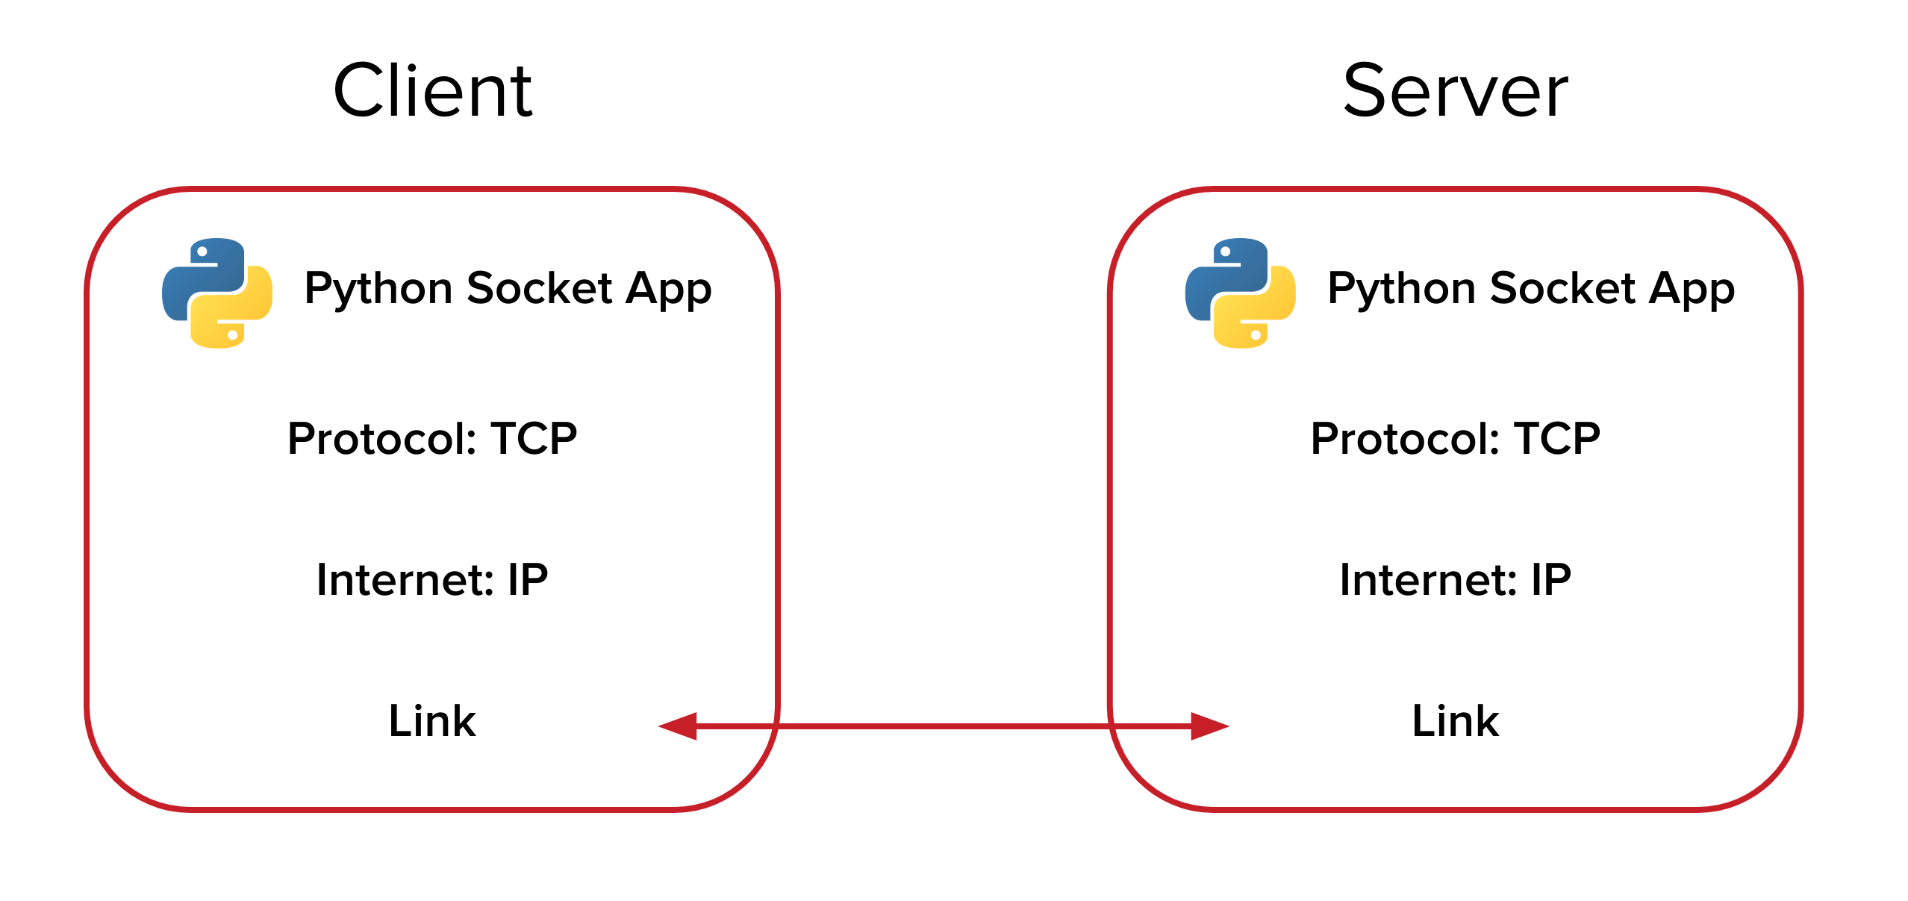
Protocols types - TCP
Connection Oriented Communications — TCP:
— The Transmission Control Protocol, better known as TCP, is one of the widely used protocols.
— Applications using this protocol will connect to each and then pass information, just like when you use the phone.
— The protocol make the data to be received safely:
- In order
- Without errors
- etc
Notes:
Python is dynamically-typed and garbage-collected. It supports multiple programming paradigms, including structured (particularly, procedural), object-oriented and functional programming.
It was built to be as readable as possible, and is significant indentation driven (Off-side rule).
The language's core philosophy is summarized in the document The Zen of Python (PEP 20), which includes aphorisms such as:
Beautiful is better than ugly.
Explicit is better than implicit.
Simple is better than complex.
Complex is better than complicated.
Readability counts.
For further reading:
Python (programming language) - Wikipedia

Slide 4
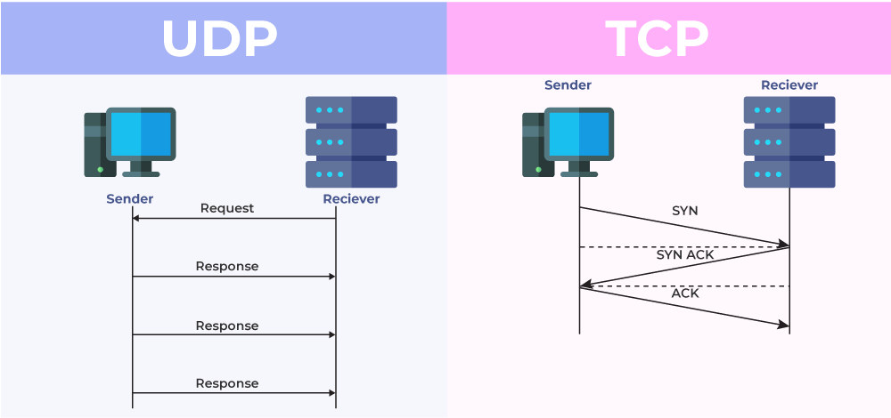
Protocols types - UDP
Connectionless Communications And UDP
— Applications need not be “connected” in order to communicate. Just as mail can be sent to your home address, data can be sent, in messages called datagrams.
— The User Datagram Protocol, better known as UDP, is the messenger protocol for this type of communication. This protocol allows directed datagrams and broadcasting.
— Connectionless communications is generally considered to be less reliable.
An application might broadcast on a network that is a temporarily down or send a message to a host that is not running.
There is no way for the sender to verify that the data has been received on the other side, in order and without errors

Slide 5
Sockets protocols - Stream Sockets
Sockets come in two main flavors, one of them being the stream socket.
Stream socket is full duplex byte stream implementing the connection oriented model.
— Server sets up a socket with a well known address.
— Clients connect to the server and data is passed on this open connection.
— When the client and or server are done the connection is terminated. The socket mechanism provides an API for each step on the client and the server. The minimal steps required are:
— Server side: — Client side:
socket() socket()
bind() connect()
listen()
accept() (possibly repeating the accept())

Slide 6
Creating sockets
Sockets are used nearly everywhere. Sockets mechanism in python placed in socket module.
The first step is to create an endpoint, a socket, with socket function:
socket(family=AF_INET, type= SOCK_STREAM, proto=0) Create’a new socket using the given address family, socket type and protocol number.
The address (and protocol) family can be:
socket.AF_INET-— for internet sockets ipv4
socket.AF_INET6 — for internet sockets ipv6
socket.AF_UNIX— unix domain sockets (UNIX IPC), not supported on all platforms
Notes:
PyCharm is currently one of the most used IDE for python development, It provides code analysis, a graphical debugger, an integrated unit tester, integration with version control systems (VCSes), and supports web development with Django as well as data science with Anaconda.
It was created by JetBrains
It is mostly popular because of many things, such as:
It is considered as an intelligent code editor, fast and safe refactoring, and smart code.
Features for debugging, profiling, remote development, testing the code, auto code completion, quick fixing, error detection and tools of the database.
Support for Popular web technologies, web frameworks, scientific libraries and version control.

Slide 7
Creating sockets — cont’d
Socket type:
-socket.SOCK_STREAM
-socket.SOCK_DGRAM
-socket.SOCK_RAW
-socket.SOCK_RDM
-socket.SOCK_SEQPACKET
Only sock_stream and sock_dgram appear to be generally useful
The proto argument - this parameter specifies a particular protocol to be used with the socket
Normally only a single protocol exists to support socket type within a given protocol family. In this case, proto stays default (zero)
— TCP for stream sockets and UDP for datagram sockets
However, it is possible that many protocols may exist, in which case a particular protocol (protocol number) must be specified
Notes:
PyCharm is currently one of the most used IDE for python development, It provides code analysis, a graphical debugger, an integrated unit tester, integration with version control systems (VCSes), and supports web development with Django as well as data science with Anaconda.
It was created by JetBrains
It is mostly popular because of many things, such as:
It is considered as an intelligent code editor, fast and safe refactoring, and smart code.
Features for debugging, profiling, remote development, testing the code, auto code completion, quick fixing, error detection and tools of the database.
Support for Popular web technologies, web frameworks, scientific libraries and version control.

Slide 8
Binding The Socket
The server now has to “bind” the socket
socket.bind(address) - bind the socket to address, so that clients can connect to it
The socket must not already be bound.
The format of address depends on the address family:
— In INET and INET6 address family, the address should be a tuple of ip and port
— In UNIX address family, the address should be a file system path
For Example:
— s.bind((socket.gethostname(), 8765))
— s.bind((‘localhost', 8765))
Notes:
PyCharm is currently one of the most used IDE for python development, It provides code analysis, a graphical debugger, an integrated unit tester, integration with version control systems (VCSes), and supports web development with Django as well as data science with Anaconda.
It was created by JetBrains
It is mostly popular because of many things, such as:
It is considered as an intelligent code editor, fast and safe refactoring, and smart code.
Features for debugging, profiling, remote development, testing the code, auto code completion, quick fixing, error detection and tools of the database.
Support for Popular web technologies, web frameworks, scientific libraries and version control.

Slide 9
Binding Internet Socket
The IP
— Server application can use socket.gethostname()so that the socket would be visible to the outside world.
— Using ‘localhost’ or '127.0.0.1' the socket will be only visible within the same machine.
— Empty sting (") specifies that the socket is reachable by.any address the machine happens to have.
The port
— low number ports are usually reserved for "well known” services (HTTP, ftp, telnet, etc).
— The non-privileged ports value should be at least 4 digits number
Notes:
PyCharm is currently one of the most used IDE for python development, It provides code analysis, a graphical debugger, an integrated unit tester, integration with version control systems (VCSes), and supports web development with Django as well as data science with Anaconda.
It was created by JetBrains
It is mostly popular because of many things, such as:
It is considered as an intelligent code editor, fast and safe refactoring, and smart code.
Features for debugging, profiling, remote development, testing the code, auto code completion, quick fixing, error detection and tools of the database.
Support for Popular web technologies, web frameworks, scientific libraries and version control.

Slide 10
Listen for connections on a socket
After binding a socket to an address the server must create a queue for clients wanting to connect to the server. A connect request from a client is queued until the server accepts the connection.
socket.listen(backlog)
— The backlog argument specifies the maximum number of queued connections
— The maximum value is system-dependent (usually 5), the minimum value is forced to 0.
Notes:
PyCharm is currently one of the most used IDE for python development, It provides code analysis, a graphical debugger, an integrated unit tester, integration with version control systems (VCSes), and supports web development with Django as well as data science with Anaconda.
It was created by JetBrains
It is mostly popular because of many things, such as:
It is considered as an intelligent code editor, fast and safe refactoring, and smart code.
Features for debugging, profiling, remote development, testing the code, auto code completion, quick fixing, error detection and tools of the database.
Support for Popular web technologies, web frameworks, scientific libraries and version control.

Slide 11
Accepting Connections
The server, having created, bound socket and created a queue for the clients, can now accept requests from clients
socket.accept()
— The return value is a pair (conn, address) where
connis anew socket object usable to send and receive data
— address is the address bound to the client
accept blocks the calling process until a connection is present.
Notes:
PyCharm is currently one of the most used IDE for python development, It provides code analysis, a graphical debugger, an integrated unit tester, integration with version control systems (VCSes), and supports web development with Django as well as data science with Anaconda.
It was created by JetBrains
It is mostly popular because of many things, such as:
It is considered as an intelligent code editor, fast and safe refactoring, and smart code.
Features for debugging, profiling, remote development, testing the code, auto code completion, quick fixing, error detection and tools of the database.
Support for Popular web technologies, web frameworks, scientific libraries and version control.

Slide 12
Closing Down The Connection
The socket can be closed using
— close
— shutdown
socket.close()- close the socket.
All future operations on the socket object will fail.
This function actually destroy the socket
socket.shutdown(how) – shut down one or both halves of the connection.
— If how is SHUT_RD, further receives are disallowed.
— If how is SHUT_WR, further sends are disallowed.
— If how is SHUT_RDWR, further sends and receives are disallowed. The socket will still be able to receive pending data that already sent.
Notes:
PyCharm is currently one of the most used IDE for python development, It provides code analysis, a graphical debugger, an integrated unit tester, integration with version control systems (VCSes), and supports web development with Django as well as data science with Anaconda.
It was created by JetBrains
It is mostly popular because of many things, such as:
It is considered as an intelligent code editor, fast and safe refactoring, and smart code.
Features for debugging, profiling, remote development, testing the code, auto code completion, quick fixing, error detection and tools of the database.
Support for Popular web technologies, web frameworks, scientific libraries and version control.

Slide 13
The client
There is no difference between the client and the server as far as creating the socket is concerned.
socket.connect(addr) — connect to remote socket at address - addr

Slide 14
Socket example

Slide 15
Socket Example — server side
import socket HOST = "" # Set the host IP address or leave it empty for localhost PORT = 50007 s = socket.socket(socket.AF_INET, socket.SOCK_STREAM) s.bind((HOST, PORT)) s.listen(1) conn, addr = s.accept() print("Connected by {}".format(addr)) while True: data = conn.recv(1024) if not data: break conn.sendall(data) conn.close()

Slide 16
import socket HOSTNAME = 'mydomain.com' HOST = socket.gethostbyname(HOSTNAME) PORT = 50007 s = socket.socket(socket.AF_INET, socket.SOCK_STREAM) s.connect((HOST, PORT)) s.sendall(b'Hello, world') data = s.recv(1024) s.close() print('Received: {}'.format(data.decode()))
Notes:
This is the main screen for opening a new project, all project are "of the same type" but not really.
We can choose our projects name by changing the last section of the location box
We can choose different environments like Virtualenv(the base one here), or Conda.
Also, we can use a new (base) interpreter or just pick one of our previously used ones if we choose so. For beginners this is all we need to know, we want a new interpreter

Slide 17
Receive data from the socket
socket.recv(bufsize) - receive data from the socket.
The return value is a string representing the data received. The maximum amount of data to be received at once is specified by bufsize.
The best bufsize match with hardware and network realities should be a relatively small power of 2, for example - 1024
Notes:
This is the main work area in PyCharm: The Coding section is where you write you code
Menu bar is all the options, setting etc.
Project explorer is where all of our current project files and folders are located, we can navigate between them there
The tools are our main uses, like the console, terminal, debug section, etc.
The run script section is where we run our current open script, of course our script can run our entire project, depends on what's connected to the script we are running

Slide 18
Send data to the socket
socket.send(string) - send data to the socket.
— Returns the number of bytes sent.
socket.sendall(string) - send data to the socket. Unlike send(), this method continues to send data from string until either all data has been sent or an error occurs.
— None is returned on success.
— Anexception is raised on error.
— In case of error, there is no way to determine how much data, + if any, was successfully sent.
Notes:
This is the main work area in PyCharm: The Coding section is where you write you code
Menu bar is all the options, setting etc.
Project explorer is where all of our current project files and folders are located, we can navigate between them there
The tools are our main uses, like the console, terminal, debug section, etc.
The run script section is where we run our current open script, of course our script can run our entire project, depends on what's connected to the script we are running

Slide 19
Getting host by name
socket.gethostbyname(hostname) - translate a host name to IPv4 address format.
The IPv4 address is returned as a string, such as '100.50.200.5’.
If the host name is an IPv4 address itself it is returned unchanged.
gethostbyname() does not support IPv6 name resolution. Use getaddrinfo() instead for
Notes:
This is the main work area in PyCharm: The Coding section is where you write you code
Menu bar is all the options, setting etc.
Project explorer is where all of our current project files and folders are located, we can navigate between them there
The tools are our main uses, like the console, terminal, debug section, etc.
The run script section is where we run our current open script, of course our script can run our entire project, depends on what's connected to the script we are running

Slide 20
Lab 01

